Slide 1


Computer Networks
Week2_Lecture1 (Chapter1)
Protocols, Network Edge and Network Core
Subhan Ullah, PhD
subhan.ullah@nu.edu.pk
BS(Computer Science) Fall-2024

Slide 2
Agenda
Network protocols
Network Edge
Network Core

Slide 3

Chapter 1: roadmap
What is the Internet?
What is a protocol?
Network edge: hosts, access network, physical media
Network core: packet/circuit switching, internet structure
Performance: loss, delay, throughput
Security
Protocol layers, service models
History

Slide 4
What’s a protocol?
Human protocols:
“what’s the time?”
“I have a question”
introductions
Network protocols:
computers (devices) rather than humans
all communication activity in Internet governed by protocols
Rules for:
… specific messages sent
… specific actions taken when message received, or other events
Protocols define the format, order of messages sent and received among network entities, and actions taken on message transmission, receipt
A protocol defines what is communicated, how it is communicated, and
when it is communicated
The key elements of a protocol are syntax, semantics, and timing
Notes:
A protocol defines what is communicated, how it is communicated, and
when it is communicated. The key elements of a protocol are syntax, semantics, and timing.
Standards provide guidelines to manufacturers, vendors, government agencies, and other service providers to ensure
the kind of interconnectivity necessary in today's marketplace and in international communications.
Data communication standards fall into two categories:
de facto (meaning "by fact" or "by convention") and de jure (meaning "by law" or "by regulation").
o De facto. Standards that have not been approved by an organized body but have
been adopted as standards through widespread use are de facto standards. De facto
standards are often established originally by manufacturers who seek to define the
functionality of a new product or technology.
o De jure. Those standards that have been legislated by an officially recognized body
are de jure standards.

Slide 5



What’s a protocol?
A human protocol and a computer network protocol:
Hi
TCP connection
request
Hi
TCP connection
response
Got the
time?
GET http://gaia.cs.umass.edu/kurose_ross
2:00
<file>
time
Q: other human protocols?
Notes:
Explain important points
distributed entities, exchanging messages (governed by protocols)
Time going down
go over definition of protocol (showing format, order of messages sent and received, and actions taken)
We’ll see these kinds of diagrams a lot

Slide 6
Chapter 1: roadmap
What is the Internet?
What is a protocol?
Network edge: hosts, access network, physical media
Network core: packet/circuit switching, internet structure
Performance: loss, delay, throughput
Security
Protocol layers, service models
History

Slide 7
















A closer look at Internet structure
mobile network
Network edge:
hosts: clients and servers
servers often in data centers
national or global ISP
local or regional ISP
home network
content
provider
network
datacenter
network
enterprise
network

Slide 8
A closer look at Internet structure
mobile network
Network edge:
hosts: clients and servers
servers often in data centers
Access networks, physical media:
wired, wireless communication links
national or global ISP
local or regional ISP
home network
content
provider
network
datacenter
network
enterprise
network

Slide 9
A closer look at Internet structure
mobile network
Network edge:
hosts: clients and servers
servers often in data centers
Access networks, physical media:
wired, wireless communication links
Network core:
interconnected routers
network of networks
national or global ISP
local or regional ISP
home network
content
provider
network
datacenter
network
enterprise
network

Slide 10
Access networks and physical media
Q: How to connect end systems to edge router?
residential access nets
institutional access networks (school, company)
mobile access networks (WiFi, 4G/5G)
mobile network
national or global ISP
local or regional ISP
Q: What to look for:
Transmission rate (bits per second) of access network?
Shared or dedicated access among users?
home network
content
provider
network
datacenter
network
enterprise
network

Slide 11
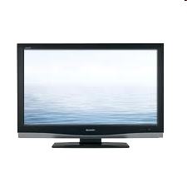


Access networks: cable-based access
cable headend
…
cable
modem
splitter
C
O
N
T
R
O
L
V
I
D
E
O
V
I
D
E
O
V
I
D
E
O
V
I
D
E
O
V
I
D
E
O
V
I
D
E
O
D
A
T
A
D
A
T
A
1
2
3
4
5
6
7
8
9
Channels
frequency division multiplexing (FDM): different channels transmitted in different frequency bands

Slide 12
Access networks: cable-based access
cable headend
…
cable
modem
splitter
CMTS
cable modem
termination system
data, TV transmitted at different
frequencies over shared cable
distribution network
ISP
HFC: hybrid fiber coax
asymmetric: up to 40 Mbps – 1.2 Gbps downstream transmission rate, 30-100 Mbps upstream transmission rate
network of cable, fiber attaches homes to ISP router
homes share access network to cable headend
Why asymmetry: https://www.maketecheasier.com/upload-speeds-slower-than-download-speeds/
Notes:
Asymmetric: download and upload are not same.

Slide 13
Access networks: digital subscriber line (DSL)
central office
telephone
network
DSL
modem
splitter
DSLAM
voice, data transmitted
at different frequencies over
dedicated line to central office
ISP
DSL access
multiplexer
use existing telephone line to central office DSLAM
data over DSL phone line goes to Internet
voice over DSL phone line goes to telephone net
24-52 Mbps dedicated downstream transmission rate
3.5-16 Mbps dedicated upstream transmission rate

Slide 14






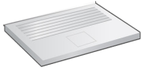
Access networks: home networks
Wireless and wired
devices
to/from headend or central office
often combined
in single box
cable or DSL modem
WiFi wireless access
point (54, 450 Mbps)
router, firewall, NAT
wired Ethernet (1 Gbps)

Slide 15




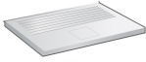



Wireless access networks
Shared wireless access network connects end system to router
via base station aka “access point”
Wide-area cellular access networks
provided by mobile, cellular network operator (10’s km)
10’s Mbps
4G cellular networks (5G coming)
Wireless local area networks (WLANs)
typically within or around building (~100 ft)
802.11b/g/n (WiFi): 11, 54, 450 Mbps transmission rate
to Internet
to Internet

Slide 16







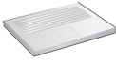
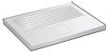
Access networks: enterprise networks
Enterprise link to
ISP (Internet)
institutional router
Ethernet
switch
institutional mail,
web servers
companies, universities, etc.
mix of wired, wireless link technologies, connecting a mix of switches and routers (we’ll cover differences shortly)
Ethernet: wired access at 100Mbps, 1Gbps, 10Gbps
WiFi: wireless access points at 11, 54, 450 Mbps

Slide 17
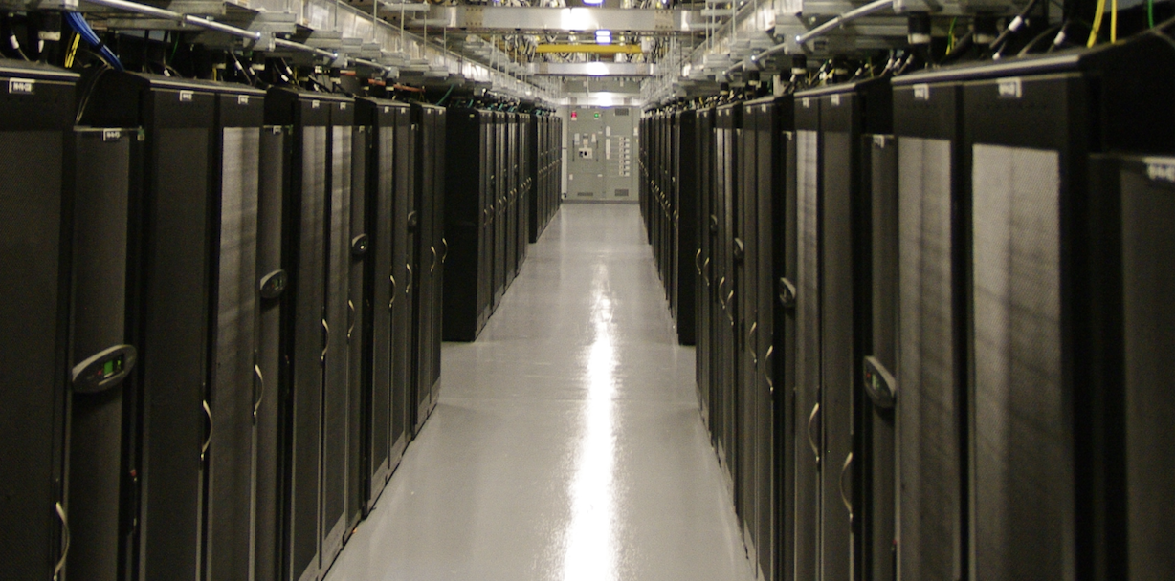
Access networks: data center networks
mobile network
high-bandwidth links (10s to 100s Gbps) connect hundreds to thousands of servers together, and to Internet
national or global ISP
local or regional ISP
home network
content
provider
network
datacenter
network
Courtesy: Massachusetts Green High Performance Computing Center (mghpcc.org)
enterprise
network

Slide 18

Host: sends packets of data
host sending function:
takes application message
breaks into smaller chunks, known as packets, of length L bits
transmits packet into access network at transmission rate R
link transmission rate, aka link capacity, aka link bandwidth
two packets,
L bits each
2
1
host
R: link transmission rate
packet
transmission
delay
time needed to
transmit L-bit
packet into link
L (bits)
R (bits/sec)
=
=
Notes:
Transmission delay is how long it takes to get all the bits of a packet onto the wire in the first place.
OR
The transmission delay is the amount of time required for the router to push out the packet.

Slide 19
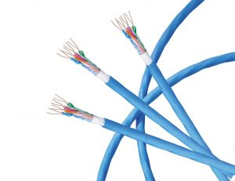
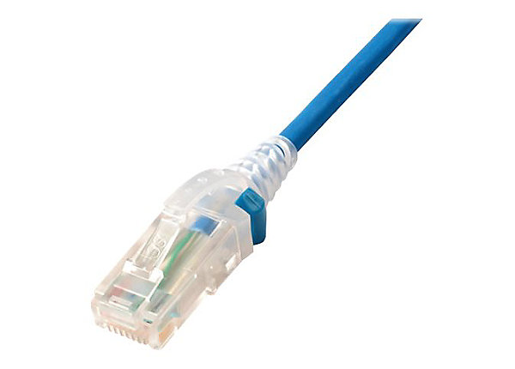
Links: physical media
bit: propagates between transmitter/receiver pairs
physical link: what lies between transmitter & receiver
guided media:
signals propagate in solid media: copper, fiber, coax
unguided media:
signals propagate freely, e.g., radio
Twisted pair (TP)
two insulated copper wires
Category 5: 100 Mbps, 1 Gbps Ethernet
Category 6: 10Gbps Ethernet

Slide 20
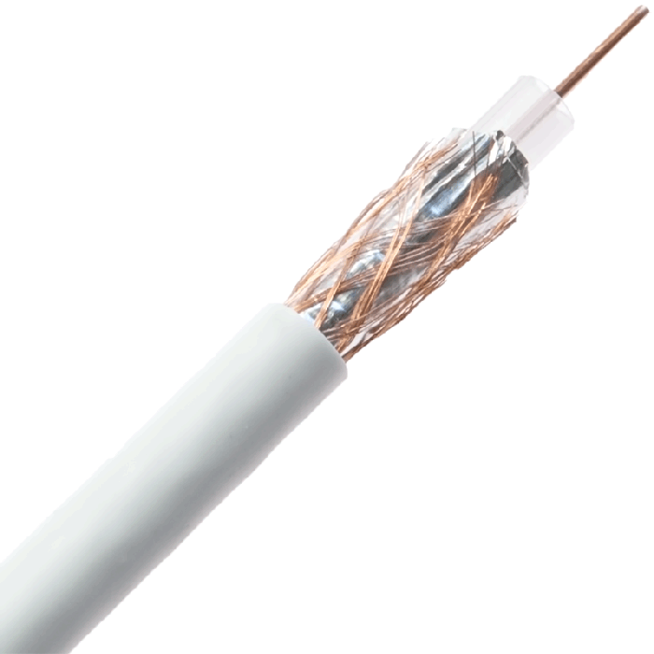
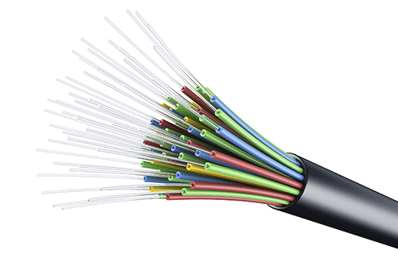
Links: physical media
Coaxial cable:
two concentric copper conductors
bidirectional
broadband:
multiple frequency channels on cable
100’s Mbps per channel
Fiber optic cable:
glass fiber carrying light pulses, each pulse a bit
high-speed operation:
high-speed point-to-point transmission (10’s-100’s Gbps)
low error rate:
repeaters spaced far apart
immune to electromagnetic noise

Slide 21
Links: physical media
Wireless radio
signal carried in various “bands” in electromagnetic spectrum
no physical “wire”
broadcast, “half-duplex” (sender to receiver)
propagation environment effects:
reflection
obstruction by objects
Interference/noise
Radio link types:
Wireless LAN (WiFi)
10-100’s Mbps; 10’s of meters
wide-area (e.g., 4G cellular)
10’s Mbps over ~10 Km
Bluetooth: cable replacement
short distances, limited rates
terrestrial microwave
point-to-point; 45 Mbps channels
satellite
up to 45 Mbps per channel
270 msec end-end delay
https://www.maketecheasier.com/properly-check-internet-speed/
https://fast.com/ OR https://www.speedtest.net/
Notes:
Reflection, abrupt change in the direction of propagation of a wave that strikes the boundary between different mediums.
Obstruction: A surf break (also break, shore break, or big wave break) is a permanent (or semi permanent) obstruction such as a coral reef, rock, shoal, or headland that causes a wave to break, forming a barreling wave or other wave that can be surfed, before it eventually collapses

Slide 22


Thank You All
☺
?
A note on the origin of these ppt slides:
All material copyright 1996-2020 J.F Kurose and K.W. Ross, All Rights Reserved
These slides are freely provided by the book authors and it represents a lot of work on their part. We would like to thank J.F Kurose and K.W. Ross.

